Slide 1
Web Based Stationery Management System
By
Name
Roll No.
Satyaki Paria
Prasanta Paul
Priyanko Sarkar
40
42
46

Slide 2
Functionalities of the system
A person should be able to
login to the system
check the availability of the stationery items
apply for new stationery request
see his/her current stationery applications and the status of the same that are submitted to him/her for approval or cancellation.
withdraw his/her new stationery request application

Slide 3
Functionalities of the system
Administrator should be able to
login to the system
check the availability of the stationery items
update the number of the stationery items
check all the orders that had been made and the timestamp of the orders.
Accept or reject a particular order.
get the cost incurred for that order.
Send mail to that user irrespective of whether the order is accepted or rejected.

Slide 4
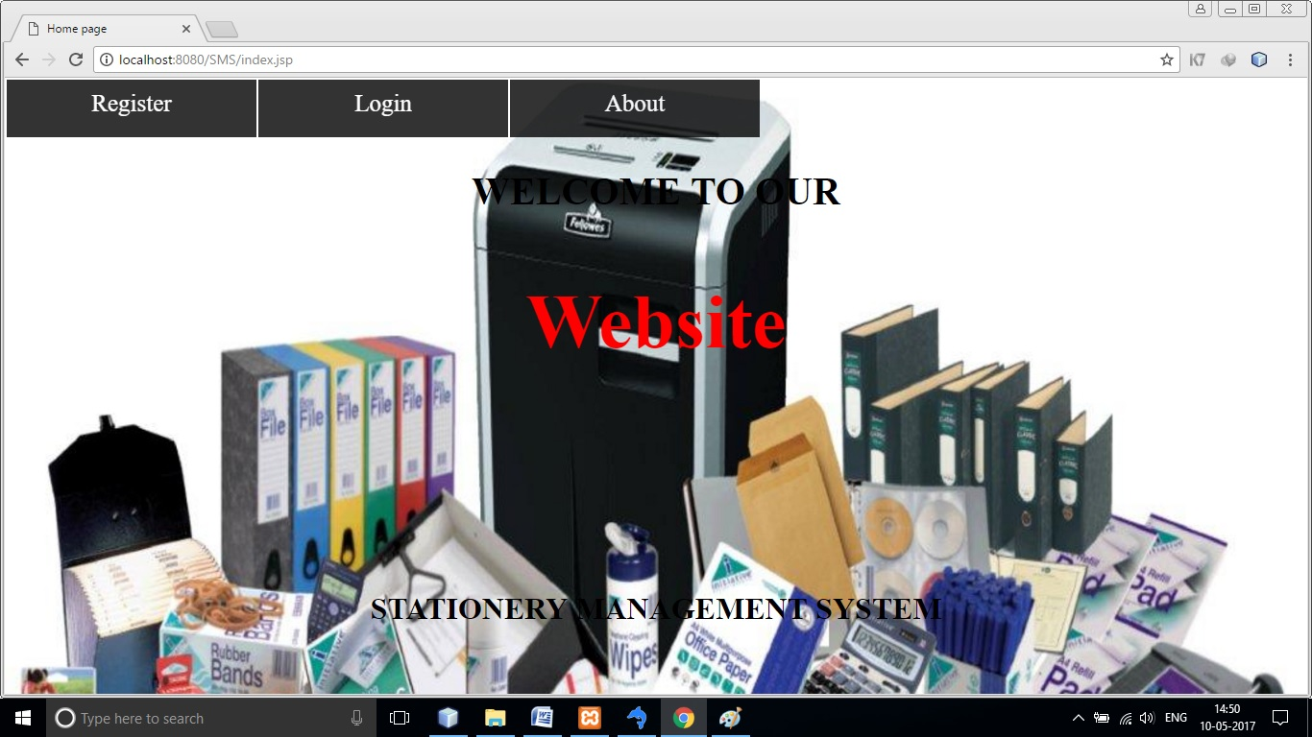
INDEX PAGE
WEB PAGE

Slide 5
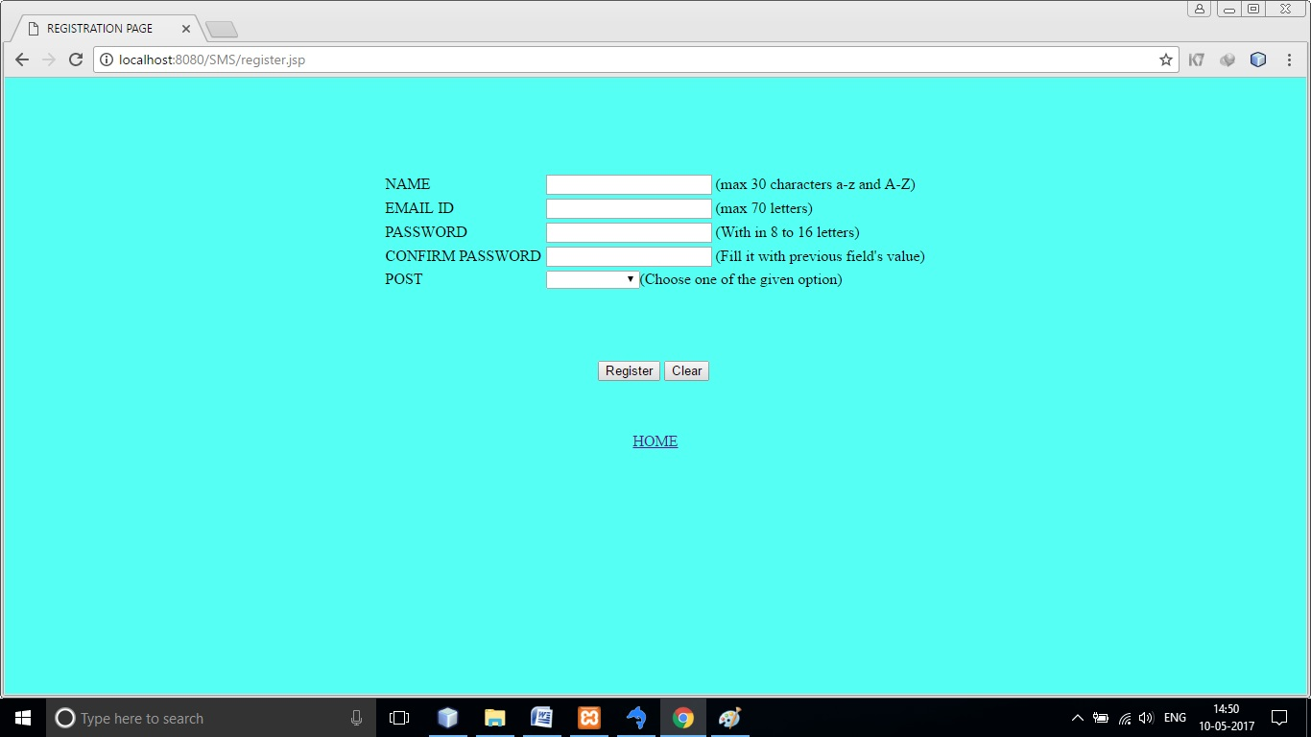
REGISTRATION PAGE
WEB PAGE

Slide 6
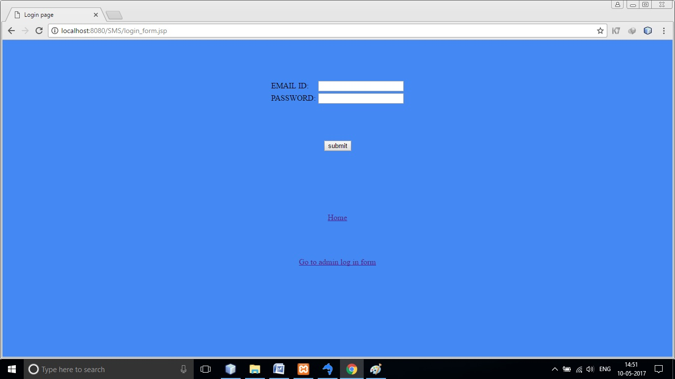
LOGIN PAGE
WEB PAGE

Slide 7
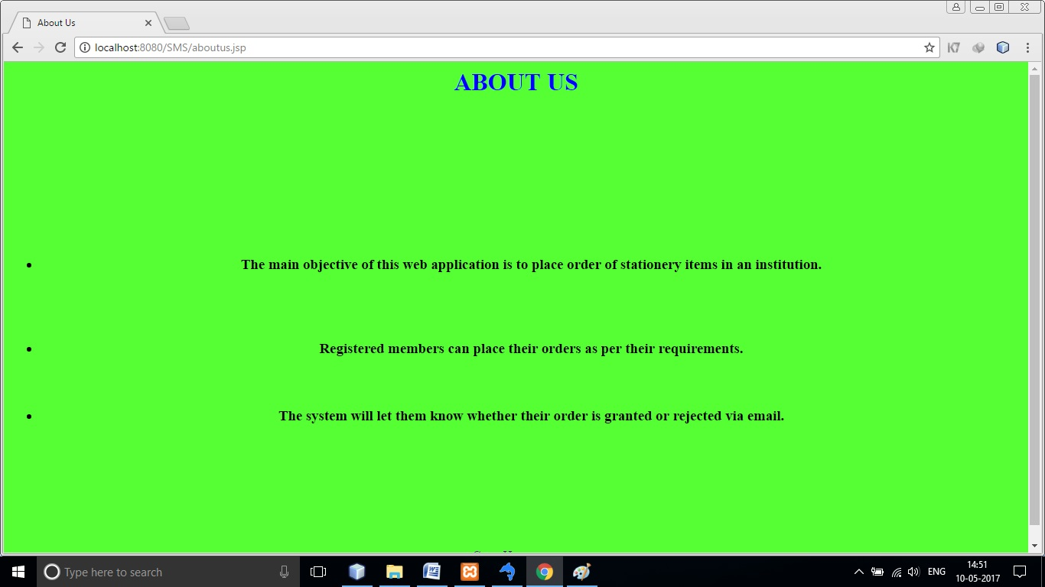
ABOUT US PAGE
WEB PAGE

Slide 8
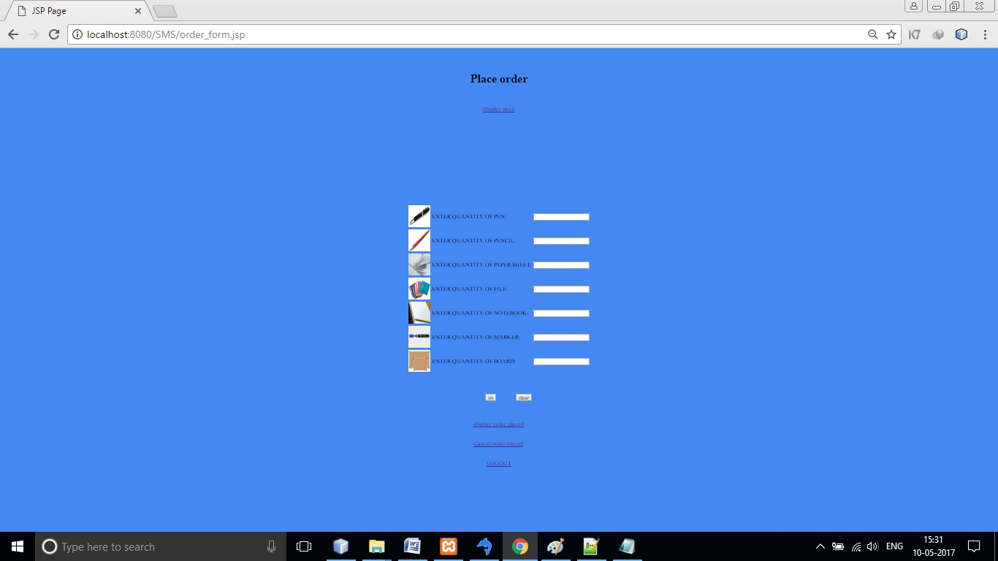
ORDER FORM PAGE
WEB PAGE

Slide 9
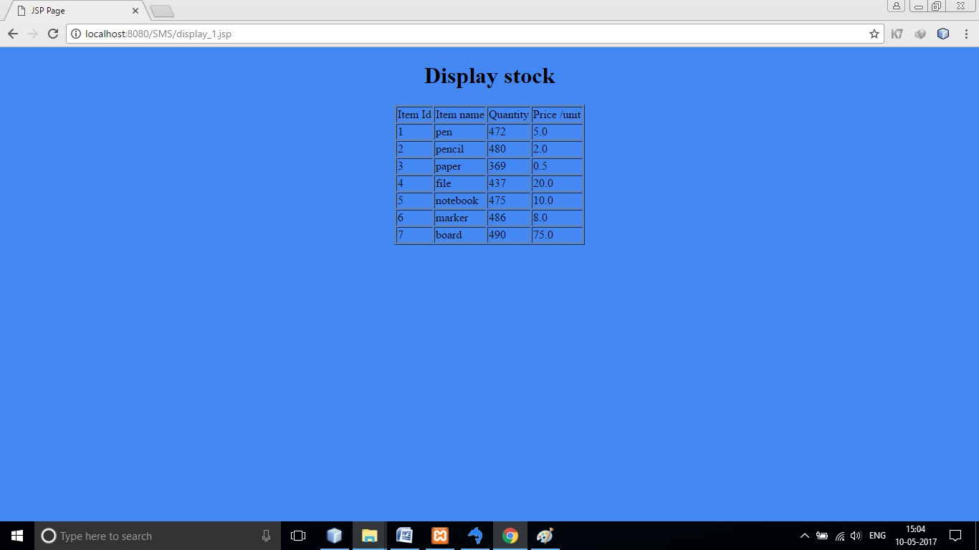
DISPLAY STOCK PAGE
WEB PAGE

Slide 10
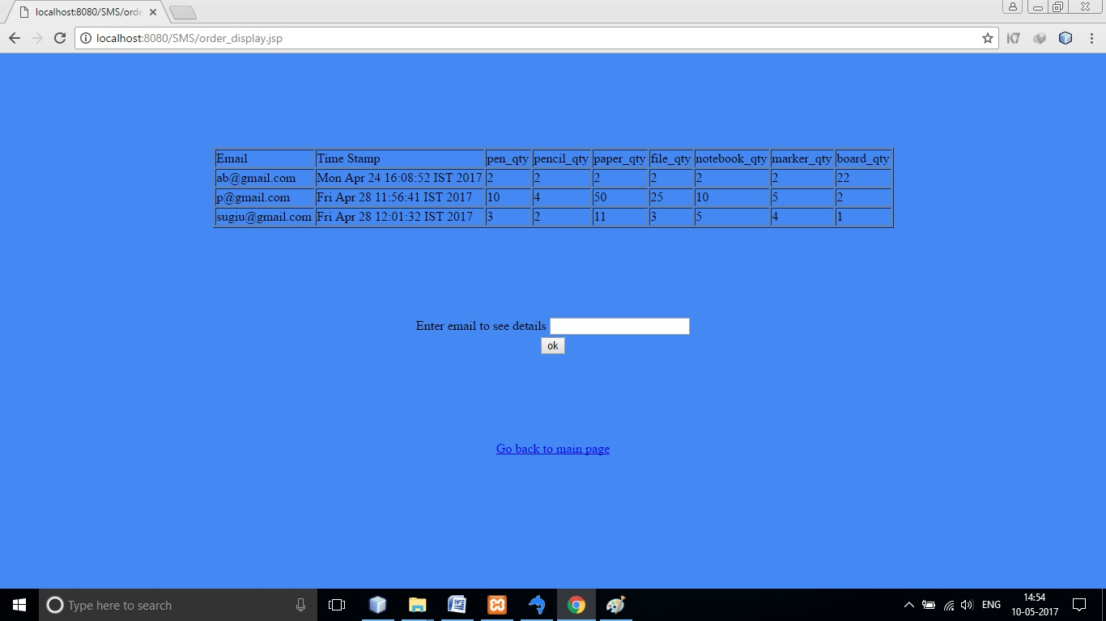
ORDER DISPLAY PAGE
WEB PAGE

Slide 11
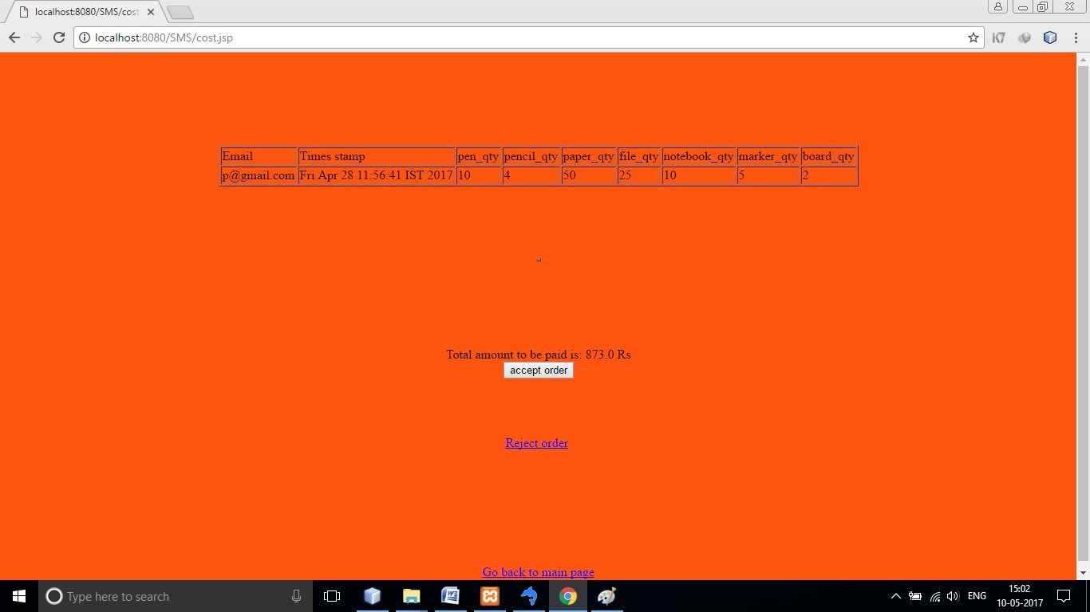
COST DISPLAY PAGE
WEB PAGE

Slide 12
DATA DICTIONARY
admin Table
Fields | Data type | Description
email | Text | Admin email I.D.
psd | Text | Admin password
cost Table
Fields | Data type | Description
pen | Number (float) | Cost of single pen
pencil | Number (float) | Cost of single pencil
paper | Number (float) | Cost of single paper
file | Number (float) | Cost of single file
notebook | Number (float) | Cost of single notebook
marker | Number (float) | Cost of single marker
board | Number (float) | Cost of single board

Slide 13
DATA DICTIONARY
login Table
Fields | Data type | Description
email | Text | User email I.D.
psd | Text | User password
order_status Table
Fields | Data type | Description
email | Text | User email I.D.
stat | Text | User order’s status

Slide 14
DATA DICTIONARY
Order Table
Fields | Data type | Description
email | Text | User email I.D.
time_stamp | Text | Exact time when order placed
pen_qty | Number (integer) | Quantity of pens ordered
pencil_qty | Number (integer) | Quantity of pencils ordered
paper_qty | Number (integer) | Quantity of papers ordered
file _qty | Number (integer) | Quantity of files ordered
notebook,_qty | Number (integer) | Quantity of notebooks ordered
marker_qty | Number (integer) | Quantity of markers ordered
board_qty | Number (integer) | Quantity of boards ordered

Slide 15
DATA DICTIONARY
stock Table
Fields | Data type | Description
item_id | Number (integer) | Item I.D. in stock
item_name | Text | Name of the item
qty | Number (integer) | Quantity of the item
ppu | Number (float) | Price per unit of item
users Table
Fields | Data type | Description
uname | Text | User name
psd | Text | User password
email | Text | User email I.D.
post | Text | User’s post in institute

Slide 16
ER DIAGRAM
PASSWORD
POST
EMAIL
EMAIL
M
ORDER ACCEPTED BY
1
USER
ADMIN
NAME
1
M
PASSWORD
ORDERS
UPDATE
N
N
ITEM
COST/UNIT
ITEM_ID
ITEM_NAME
QUANTITY

Slide 17
USE CASE DIAGRAM
H
<< include >>
REGISTER
VALIDATE
PLACE ORDER
CANCEL ORDER
USER
DISPLAY STOCK
CHECK STOCK
<< include >>
UPDATE STOCK
<< extends >>
ACCEPT ORDER
CHECK ORDER
ADMIN
REJECT ORDER
<< extends >>

Slide 18
DFD
REGISTER
STORE USER INFORMSATION
ENTER DETAILS
USERS
PLACE ORDER
ENTER VALUES
USER STORE ORDER
USER
CANCEL REQUEST
REMOVE ORDER
ORDERS
CANCEL ORDER
DISPLAY STOCK
DISPLAY STOCK RECORD
DISPLAY STOCK
RECORD
SEND EMAIL
ADMIN
CHECK REQUEST
RECORD
ENTER DETAILS
CHECK STOCK
CHECK ORDER
ENTER VALUES
USE
STOCK
SEND MAIL
UPDATE STOCK
UPDATE
ENTER DETAILS
COST
ENTER DETAILS
ACCEPT ORDER
USE
REJECT ORDER
REMOVE ORDER
ORDERS
REMOVE ORDER

